Slide 1
CS305: Computer Architecture
Problem set
https://www.cse.iitb.ac.in/~biswa/courses/CS305/main.html

Slide 2
Basics: Pipeline, performance metrics

Slide 3
Problem-1
Consider the unpipelined processor that has a 1 ns clock cycle and that it uses 4 cycles for ALU operations and branches and 5 cycles for memory operations. Assume that the relative frequencies of these operations are 40%, 20%, and 40%, respectively. Suppose that pipelining the processor adds 0.2 ns of overhead to the clock. Ignoring any latency impact, how much speedup in the instruction execution rate will we gain from a pipeline?

Slide 4
Solution
The average instruction rate (execution time) on the unpipelined processor =
Clock cycle X Average CPI
= 1 ns X [(40% + 20%)X 4 + 40% X 5]
= 1 ns X 4.4 = 4.4 ns

Slide 5
Solution Contd.
In the pipelined processor,
Clock cycle time = 1ns + 0.2ns latch overhead = 1.2ns
Speedup = 4.4/1.2 = 3.66 times
tips: The question does not mention #pipeline stages. If you think deep, it does not matter because after a while one instruction will be done in one cycle, so speedup is just the ratio of cycle time

Slide 6
Problem-2
Consider a 4-stage pipelined CPU with the following details in terms of #cycles: I1 to I4 are four instructions
 | Stage-1 | Stage-2 | Stage-3 | Stage-4
I1 | 2 | 1 | 1 | 1
I2 | 1 | 3 | 2 | 2
I3 | 2 | 1 | 1 | 3
I4 | 1 | 2 | 2 | 2
How many cycles will it take to execute (i) I1 to I4 once (ii) I1 to I4 twice

Slide 7
Try it on your own for two iterations (I1 to I4 twice)
The answer will be 23

Slide 8
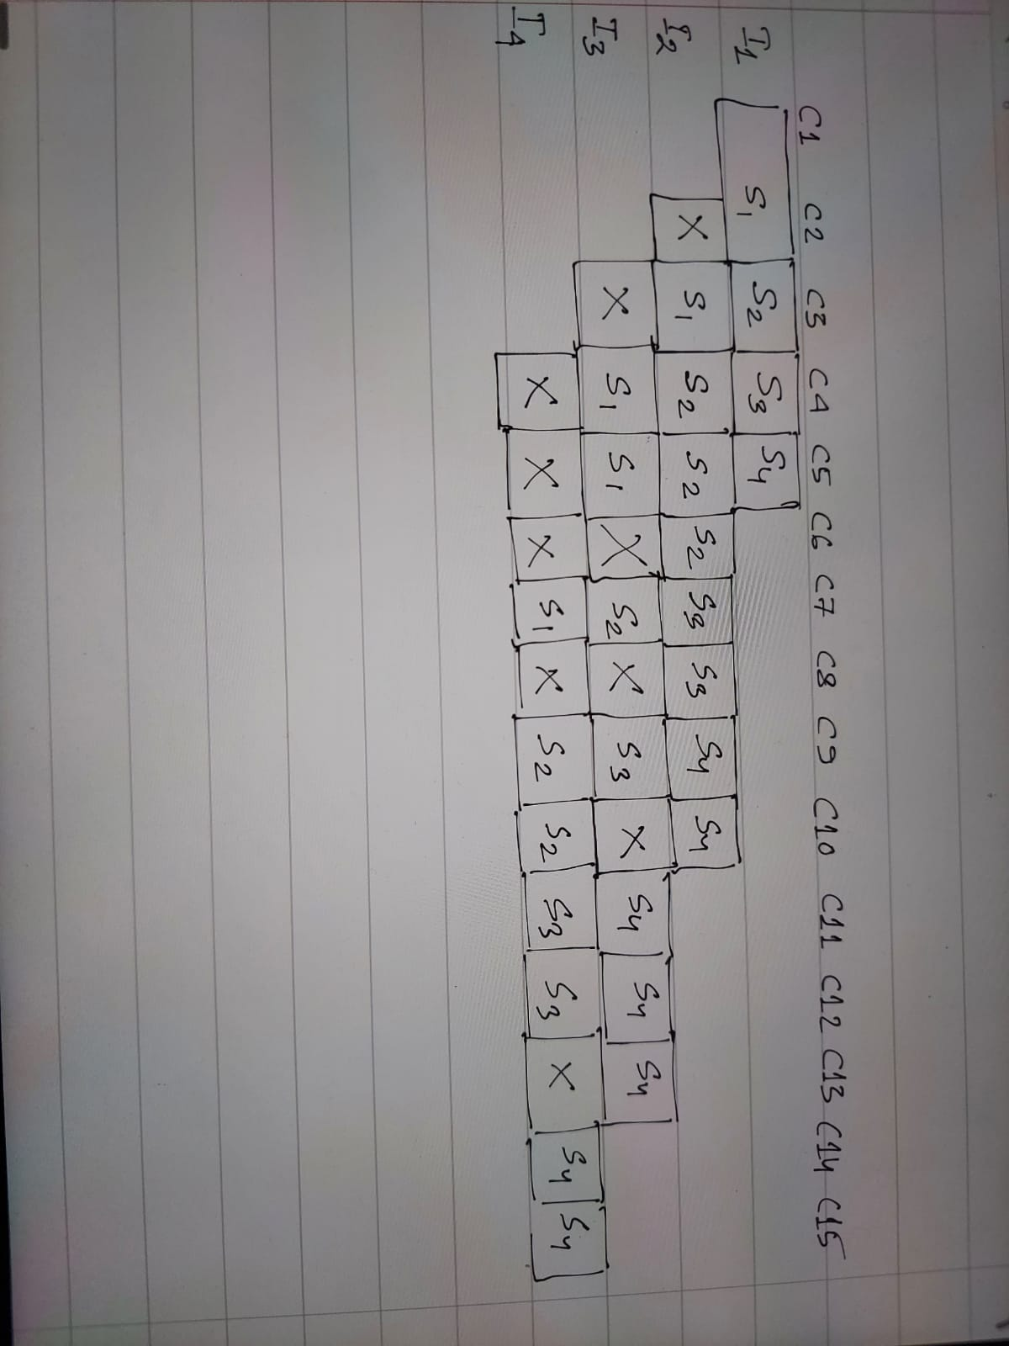
Solution (Make sure no two instructions use the same stage at the same time)

Slide 9
Problem 3
Consider a datacenter processor running at 100% utilization at 100 W, 50% of the power is attributed to leakage. What is the total power dissipation when the processor is running at 25% utilization?
Total power =
dynamic power + leakage power
50W x 25% + 50W = 62.5W

Slide 10
Problem 4
Your laptop has an IPC that is 30% worse than your friend’s laptop. It has a clock speed that is 40% higher than friend’s laptop. If the ISA and the compiler used are the same, what is the speedup with your laptop compared to your friend’s laptop?

Slide 11
Solution
Speed up = Your laptop’s performance
----------------------------------
Your friend’s laptop’s performance
Execution time = cycle time X CPI X #Instructions
Performance = 1/execution time
= clock speed X IPC/instructions

Slide 12
Solution Contd.
Speedup = Yours (clock speed X IPC)
-------------------------------------------
Your Friend’s (clock speed X IPC)
= 1.4 X 0.7
= 0.98

Slide 13
Pipeline hazards, forwarding, branch prediction

Slide 14
Problem-1
Consider the following instruction runs on a 5-stage pipelined processor:
add $2, $3, $4
lw $1, 4($2)
sub $4, $1, $5
add $6, $1, $5
and $8, $1, $7
Find the # of cycles needed to execute these instructions a)without operand forwarding, b)with operand forwarding.

Slide 15
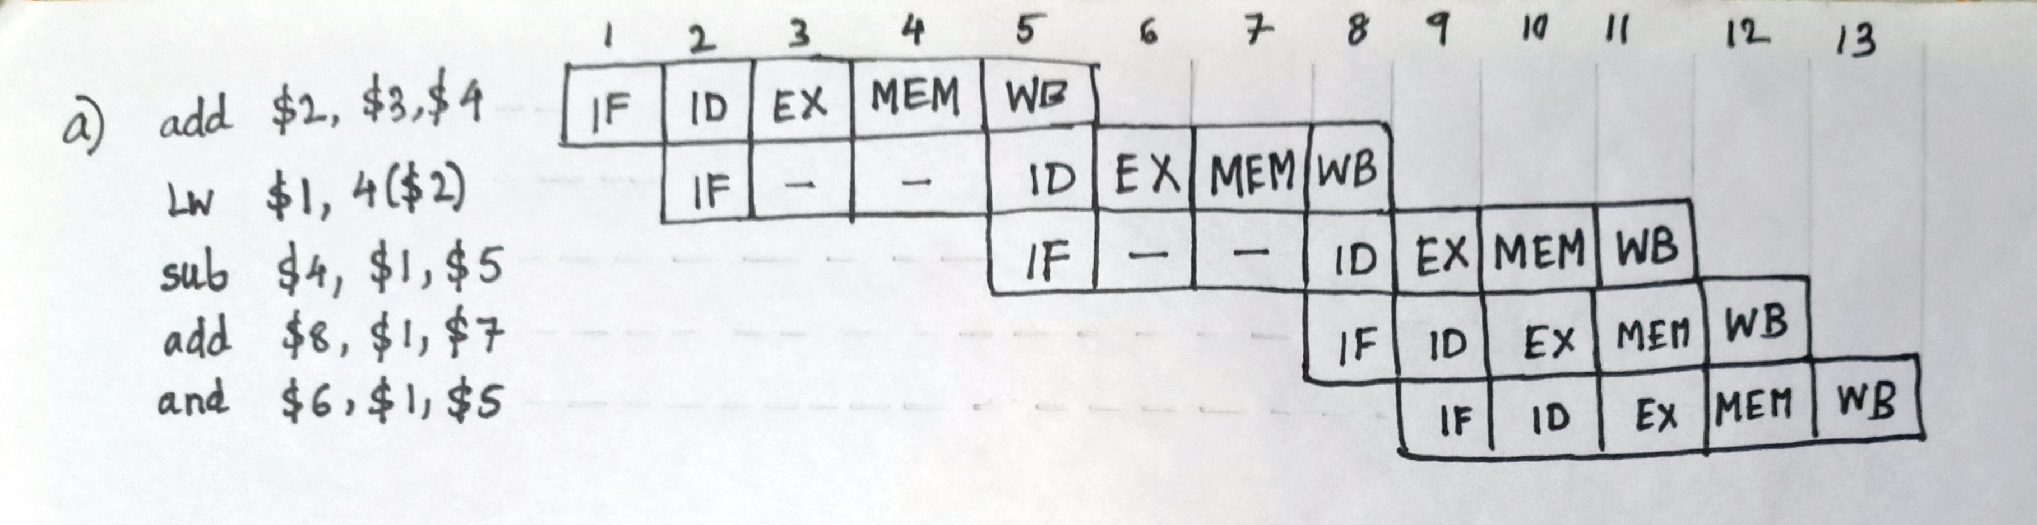
Solution

Slide 16
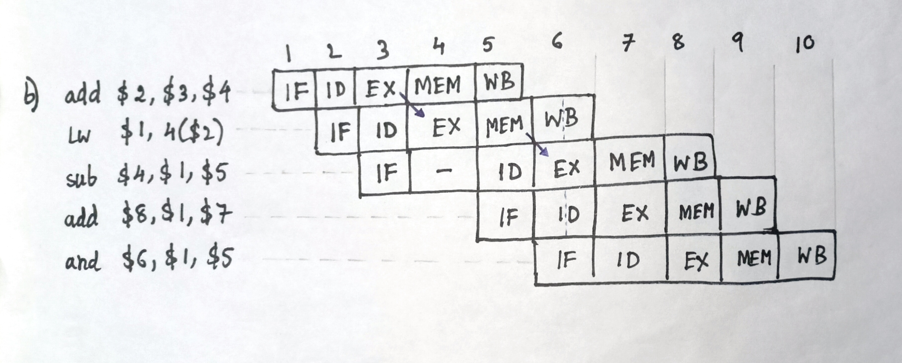
Solution

Slide 17
Problem-2
An instruction pipeline has five stages where each stage take 2 nanoseconds. All branches are resolved after the execute stage.
Calculate the average instruction execution time assuming that 20% of all instructions executed are branch instructions. Ignore the fact that some branch instructions may be conditional.
Assume 80% of all branch instructions are conditional branch instructions, and 50% of the conditional branch instructions are such that the branch is taken, calculate the average instruction execution time. Assume an always-not taken predictor is used.

Slide 18
Solution
a) # of stalls per branch = 2
avg. CPI = 1 + stall for branches
= 1 + 0.2*2
= 1.4
avg. instruction exec. Time = 1.4 * 2 ns
= 2.8 ns
b) avg. CPI = 1 + 0.2(0.2*2 + 0.8*0.5*2)
= 1.24
avg. instruction exec. Time = 1.24 * 2 ns
= 2.48 ns

Slide 19
Problem-3
Consider the repeating pattern (e.g., in a loop) of branch outcomes: T, NT, T, T, NT
What is the accuracy of always-taken and always-not-taken predictors for this sequence of branch outcomes?
What is the accuracy of the two-bit hysteresis predictor(the one in lecture slides) for the first 5 branches in this pattern, assuming that the predictor starts off in the strongly not-taken state?
What is the accuracy of the two-bit predictor if this pattern is repeated forever?

Slide 20
Solution
accuracy of always taken = 60 %
accuracy of always not-taken = 40 %
accuracy of 2-bit predictor on 1st 5 branch = 20 %
accuracy of 2-bit predictor(forever) = 60 %

Slide 21
Caches

Slide 22
Problem-1
Consider a 4-way set associative cache consisting of 128 lines with a line size of 64 bytes. The CPU generates a 20-bit physical address . Find the number of bits in the TAG, INDEX and BYTE fields.

Slide 23
Solution
Number of sets = # of lines in cache/associativity
= 128/4 = 32 = 2⁵
Block size = 2⁶ Bytes
Address bits:
tag | index | Byte offset

Slide 24
Problem-2
How many total bits are required for a direct-mapped cache with 16 KB of data and 16 B blocks, assuming a 32-bit address?

Slide 25
Solution
Data in cache = 16 KB = 2¹⁴ B
Block size = 2⁴ B
# of cache lines = 2¹⁴/2⁴ = 2¹⁰
Address bits:
Total cache size = 2¹⁴ * 8 + 2¹⁰(18 + 1) bits = 147 Kbits
tag | index | Byte offset

Slide 26
Problem-3
Consider a direct-mapped cache with 64 blocks and a block size of 16 bytes. To what block number does byte address 2000 map?
Also find the set number to which the address will be mapped to, in case the cache is set associative with an associativity of 4.

Slide 27
Solution
Direct-mapped:
Block address = byte address / bytes per address
= 2000/16
= 125
Block # = (block address) mod (# of blocks in cache)
= 125 mod 64
= 61

Slide 28
Solution
Set associative:
# of sets in cache = 64/4 = 16 sets
set # = (block address) mod (# of sets in cache)
= 125 mod 16
= 13

Slide 29
Problem-4
Assume the miss rate of an instruction cache is 2% and the miss rate of the data cache is 4%. If a processor has a CPI of 2 without any memory stalls and the miss penalty is 100 cycles for all misses, determine how much faster a processor would run with a perfect cache that never missed. Assume the frequency of all loads and stores is 36%.

Slide 30
Solution
Instruction miss cycles = IC x 0.02 x 100 = 2 IC (IC = instruction count)
Data miss cycles = IC x 0.36 x 0.04 x 100 = 1.44 IC
Total # of memory stall cycles = (2 + 1.44) IC = 3.44 IC
CPI including memory stalls = 2 + 3.44 = 5.44
speedup = CPU time with stalls / CPU time with perfect cache
= IC x CPI_{stall} x clock / IC x CPI_{perfect} x clock
= CPI_{stall}/CPI_{perfect} = 5.44/2 = 2.72

Slide 31
Problem-5
Consider a 2-way set associative cache with 256 blocks and uses LRU replacement. Initially the cache is empty.
The following sequence of access to memory blocks:
{0, 128, 256, 128, 0, 128, 256, 128, 1, 129, 257, 129, 1, 129, 257, 129}
is repeated 10 times.
Find the number of compulsory and conflict misses for the cache.

Slide 32
Solution
1st iteration:
Compulsory misses = 6
Conflict misses = 4
For each subsequent iteration:
Compulsory misses = 0
Conflict misses = 8
Total compulsory misses = 6
Total conflict misses = 4 + 8*9 = 76

Slide 33
Problem-6
Consider a system with 2 level cache. Access times of Level 1 cache, Level 2 cache and main memory are 1 ns, 10 ns, and 500 ns respectively. The hit rates of Level 1 and Level 2 caches are 0.8 and 0.9, respectively. Find out the average memory access time of the system.

Slide 34
Solution
Assume,
L1 access time = t₁ L1 hit rate = h₁
L2 access time = t₂ L2 hit rate = h₂
Mem. Access time = t_{m}
AMAT = t₁ + (1 – h₁ )( t₂ + ( 1 – h₂ ) t_{m} )
= t₁ + (1 – h₁ ) t₂ + ( 1 – h₁ )( 1 – h₂ ) t_{m}
= 1 + 0.2 x 0.9 x 10 + 0.2 x 0.1 x 500 = 13 ns

Slide 35
Prefetcher, coherence, DRAM, I/O

Slide 36
Problem-1
An architect is designing the prefetch engine for his machine. He first runs two applications A and B on the machine, with a stride prefetcher.
Application A:
uint8_t a[1000];
sum = 0;
for (i = 0; i < 1000; i += 4)
{
sum += a[i];
}
Application B:
uint8_t a[1000];
sum = 0;
for (i = 1; i < 1000; i *= 4)
{
sum += a[i];
}
i and sum are in registers, while the array a is in memory. A cache block is 4 bytes in size.
What is the prefetch accuracy and coverage for applications A and B using a stride prefetcher. This stride prefetcher detects the stride between two consecutive memory accesses and prefetches the cache block at this stride distance from the currently accessed block.

Slide 37
Solution
Application A’s prefetch accuracy is 248/249 and coverage is 248/250.
Application A accesses a[0], a[4], a[8], ... a[996]. It has 1000/4 = 250 accesses to memory. The first two accesses to a[0] and a[4] are misses. After observing these two accesses, the prefetcher learns that the stride is 4 and starts prefetching a[8], a[12], a[16] and so on until a[1000] (on the access to a[996], a[1000] is prefetched; however, it is not used). In all, 249 cache blocks are prefetched, while only 248 are used.
Application B’s prefetch accuracy is 0 and coverage is 0.
Application B accesses a[1], a[4], a[16], a[64] and a[256]. It has five accesses to memory. However, there isn’t a constant stride between these accesses, as the array index is multiplied by 4, rather than being incremented/decremented by a constant stride. Hence, the stride prefetcher cannot prefetch any of the accessed cache blocks and the prefetch accuracy and coverage are both 0.

Slide 38
Problem-2
The following table shows two processors and their read/write operations on two different words of a cache block X (initially X[0] = X[1] = 0).
List the possible values of the given cache block for a correct cache coherence protocol implementation. List at least one more possible value of the block if the protocol doesn't ensure cache coherency.
 | P1 | P2
a. | X[0] ++; X[1] = 4; | X[0] = 2; X[1] ++;
b. | X[0] ++; X[1] += 3; | X[0] = 5; X[1] =2;

Slide 39
Solution
a. Coherent : [2, 4], [3, 4], [2, 5], [3, 5]
Non-coherent: [1, 1]
b. Coherent : [5, 5], [6, 5], [5, 2], [6, 2]
Non-coherent: [1, 2]

Slide 40
Problem-3
A machine with a 4 GB DRAM main memory system has 4 channels, 1 rank per channel and 4 banks per rank. The cache block size is 64 bytes.
You are given the following byte addresses and the channel and bank to which they are mapped:
Byte: 0x0000 ⇒ Channel 0, Bank 0
Byte: 0x0100 ⇒ Channel 0, Bank 0
Byte: 0x0200 ⇒ Channel 0, Bank 0
Byte: 0x0400 ⇒ Channel 1, Bank 0
Byte: 0x0800 ⇒ Channel 2, Bank 0
Byte: 0x0C00 ⇒ Channel 3, Bank 0
Byte: 0x1000 ⇒ Channel 0, Bank 1
Byte: 0x2000 ⇒ Channel 0, Bank 2
Byte: 0x3000 ⇒ Channel 0, Bank 3
Determine which bits of the address are used for each of the following address components. Assume row bits are higher order than column bits:
• Byte on bus Addr [ 2 : 0 ]
• Channel bits (channel bits are contiguous) Addr [ : ]
• Bank bits (bank bits are contiguous) Addr [ : ]
• Column bits (column bits are contiguous) Addr [ : ]
• Row bits (row bits are contiguous) Addr [ : ]

Slide 41
Solution
• Byte on bus Addr [ 2 : 0 ]
• Channel bits (channel bits are contiguous) Addr [ 11 : 10 ]
• Bank bits (bank bits are contiguous) Addr [ 13 : 12 ]
• Column bits (column bits are contiguous) Addr [ 9 : 3 ]
• Row bits (row bits are contiguous) Addr [ 31 : 14 ]

Slide 42
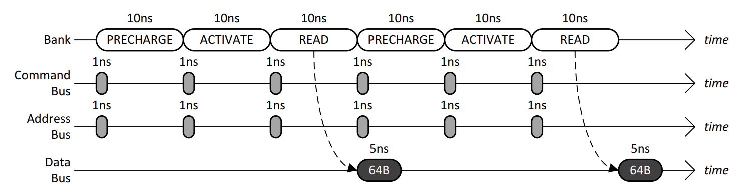
Problem-4
The following timing diagram shows the operation of a single DRAM channel and a single DRAM bank for two back-to-back reads that conflict in the row-buffer. Immediately after the bank has been busy for 10ns with a READ, data starts to be transferred over the data bus for 5ns.
(a) Given a long sequence of back-to-back reads that always conflict in the row-buffer, what is the data throughput of the main memory system?
(b) To increase the data throughput, the main memory designer is considering adding more DRAM banks to the single DRAM channel. Given a long sequence of back-to-back reads to all banks that always conflict in the row-buffers, what is the minimum number of banks that is required to achieve the maximum data throughput of the main memory system?

Slide 43
Solution
(a) 64B/30ns = 32B/15ns = 32GB/15s = 2.13GB/s
(b) 30ns/5ns = 6

Slide 44
Problem-5
Consider a typical disk that rotates at 15000 rotations per minute (RPM) and has a transfer rate of 50×10⁶ bytes/sec. If the average seek time of the disk is twice the average rotational delay and the controller's transfer time is 10 times the disk transfer time, find the average time (in milliseconds) to read or write a 512-byte sector of the disk.

Slide 45
Solution
Average time to read/write = Avg. seek time + Avg. rotational delay + Transfer time
Rotational delay =60/15000 s = 4 ms
Avg. rotational delay =(1/2) x 4 = 2 ms
Avg. seek time =2 × 2 ms = 4 ms
Disk transfer time =512 / 50 x 10⁶ = 0.0102 ms
Effective transfer time =10 × disk transfer time = 0.102 ms
So, avg. time to read/write = 4 + 2 + 0.0102 + 0.102 =6.11 ms ≈6.1 ms

Slide 46
Problem-6
The size of the data count register of a DMA controller is 16 bits. The processor needs to transfer a file of 29,154 kilobytes from disk to main memory. The memory is byte addressable. Find the minimum number of times the DMA controller needs to get the control of the system bus from the processor to transfer the file from the disk to main memory .

Slide 47
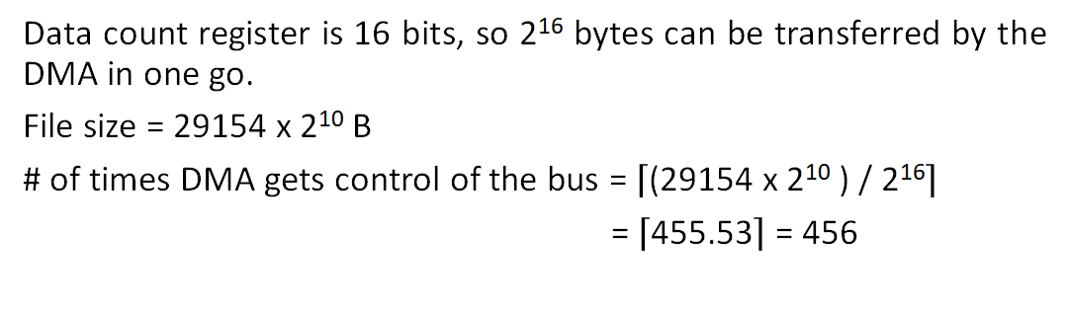
Solution

